Slide 1
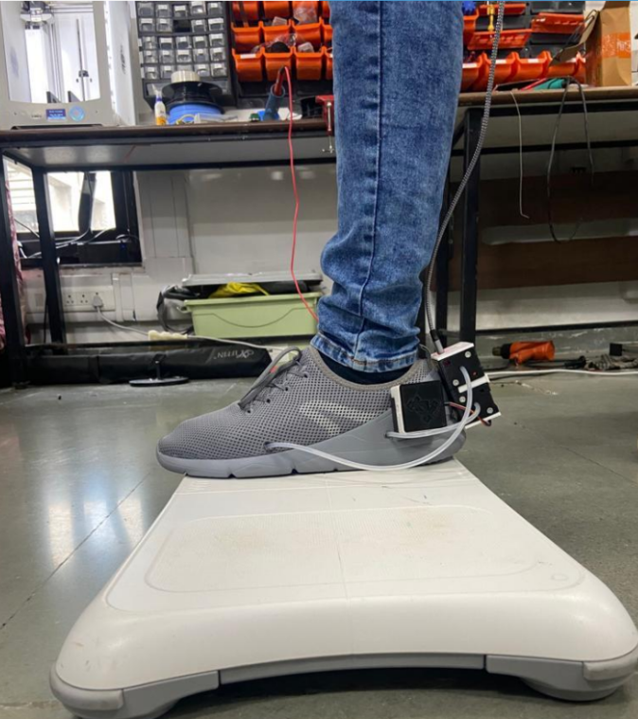

Smart Shoes
HCR Lab Meeting
Dhruv Thakkar

Slide 2
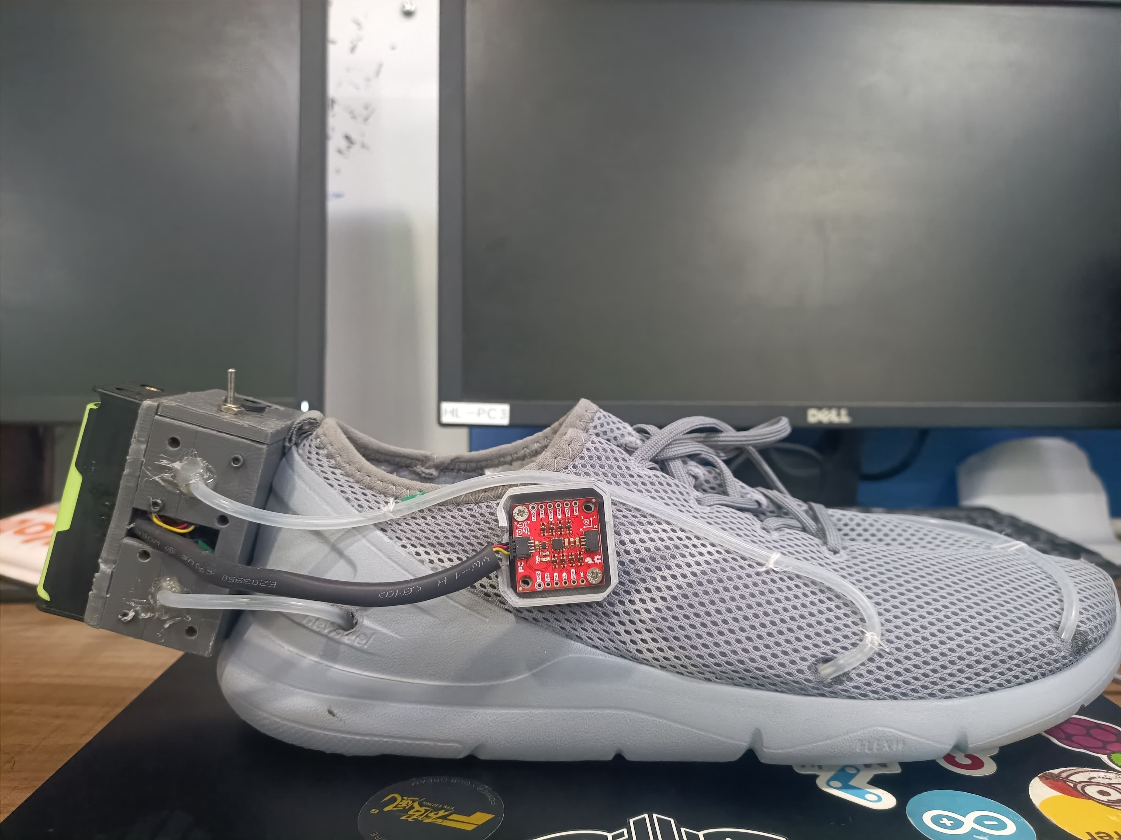
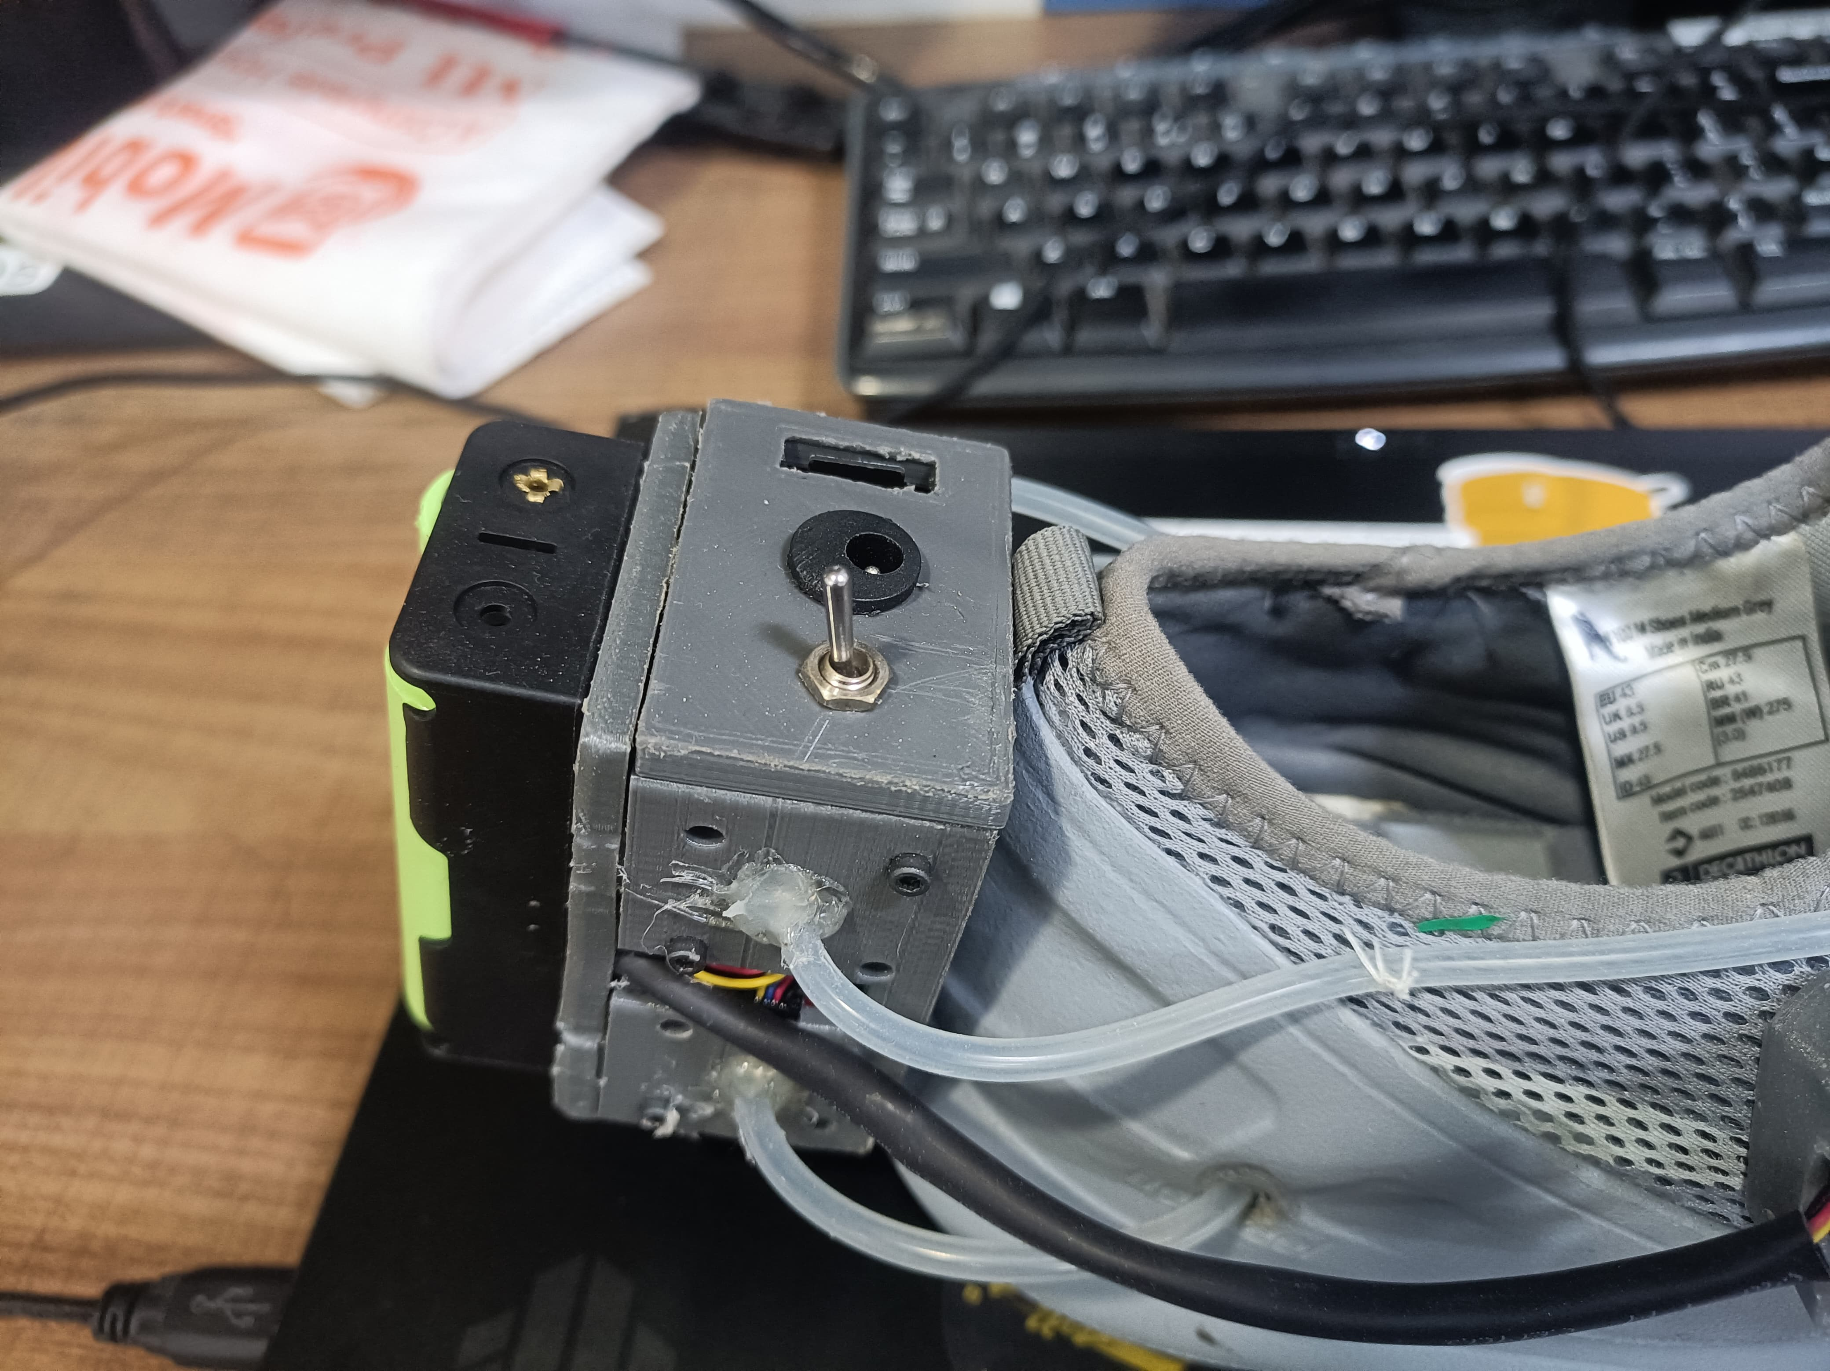
Final Hardware

Slide 3
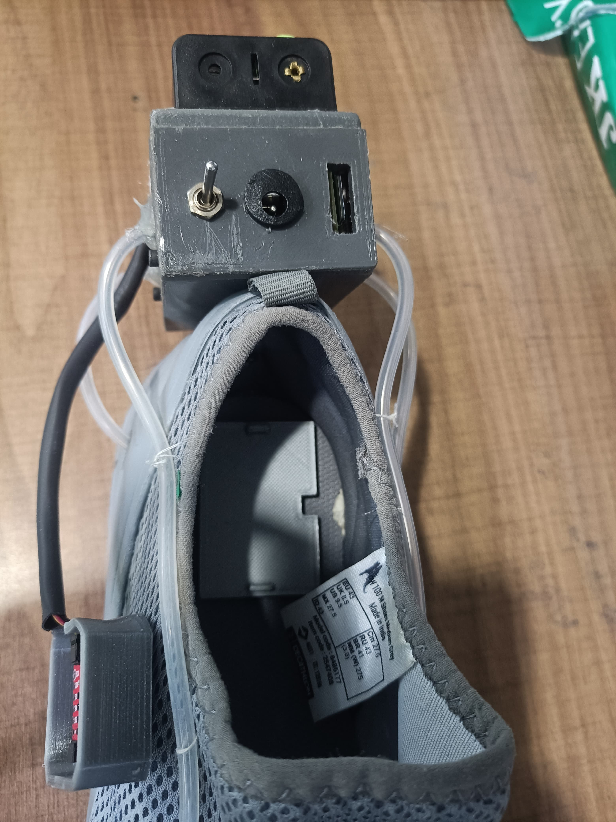
Data synchronization
The Challenge:
Force plates record data at 200 Hz with fixed time stamp.
Teensy record at random frequency (30 – 40 Hz) .
Both systems are independent and must synchronize their events during the experiment
The Solution:
Using a hardware digital signal from Vicon for synchronization at the start of the experiment.
Down-Sampling of Force Plate data w.r.t to the time stamps recorded by both system.
DC Jack

Slide 4
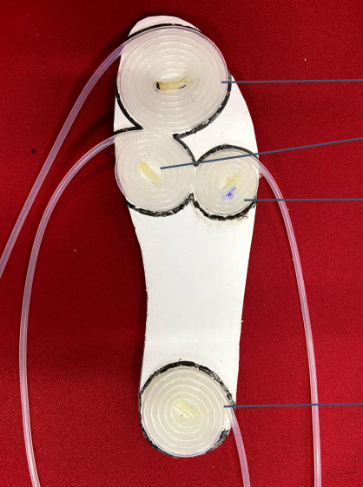
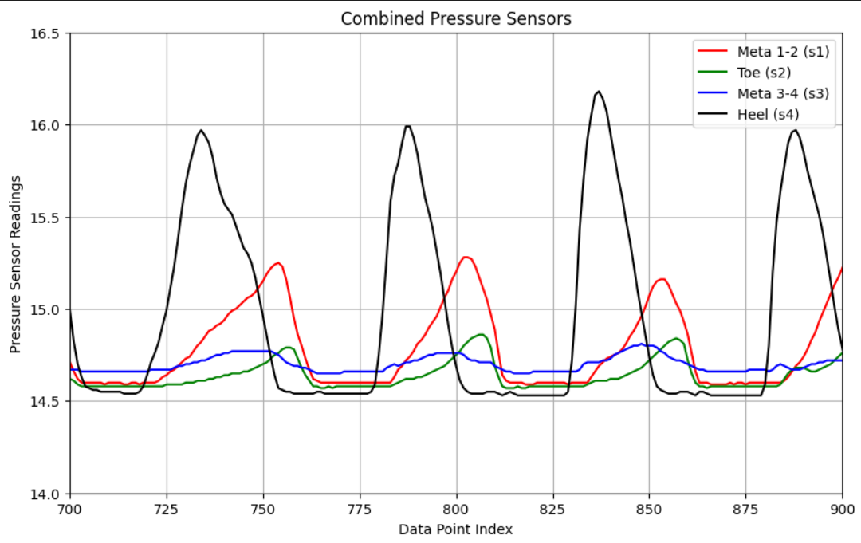
Temporary data collections
Toe
Meta 1-2
Meta 3-4
Pressure Sensor data while walking without Force Plates
Heel

Slide 5
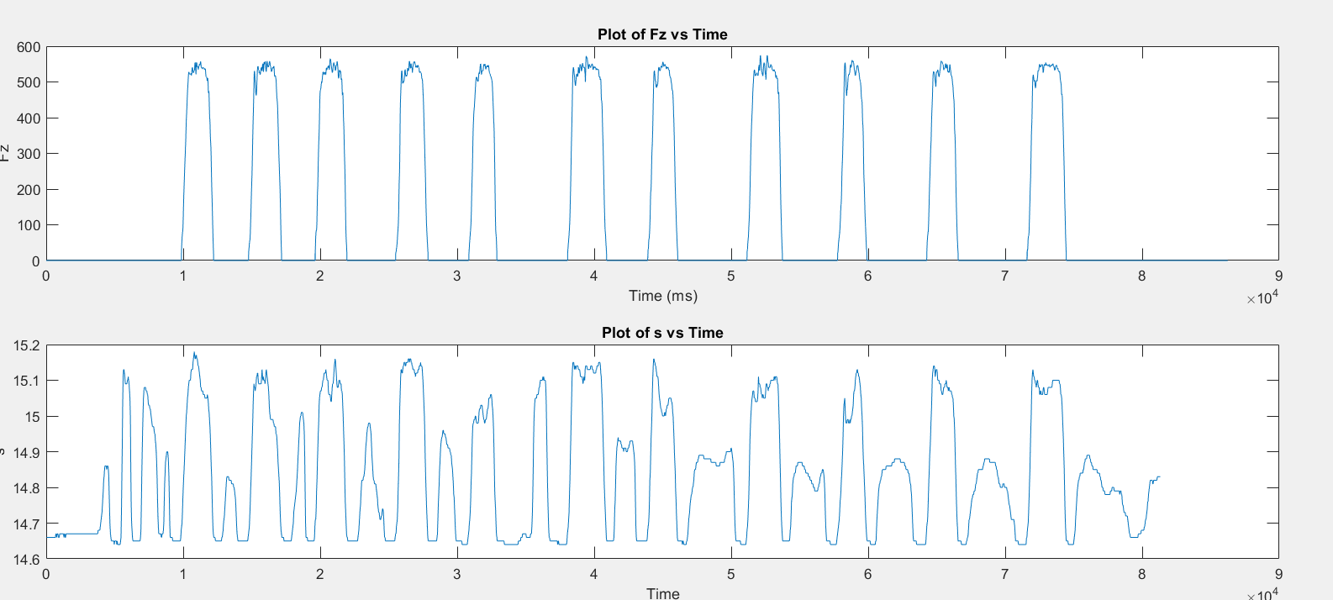
Temporary data collections
Average Pressure Sensor data stepping up on Force Plates

Slide 6
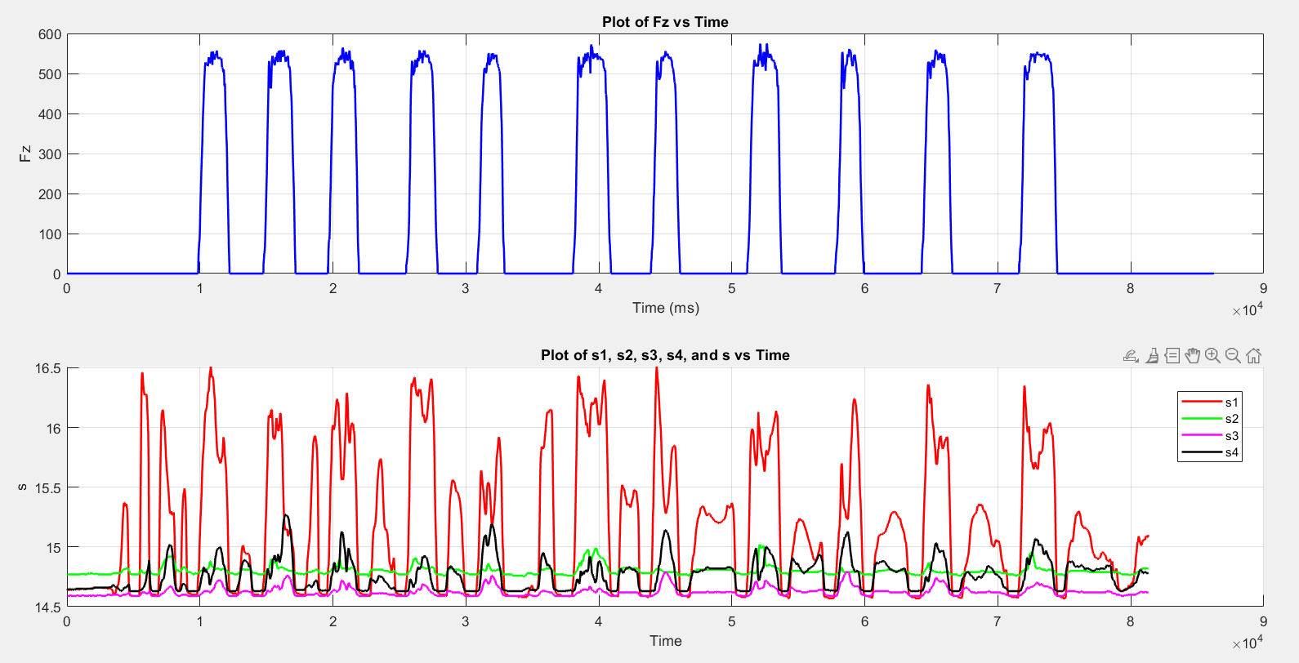
Temporary data collections
All Pressure Sensor data stepping up on Force Plates

Slide 7
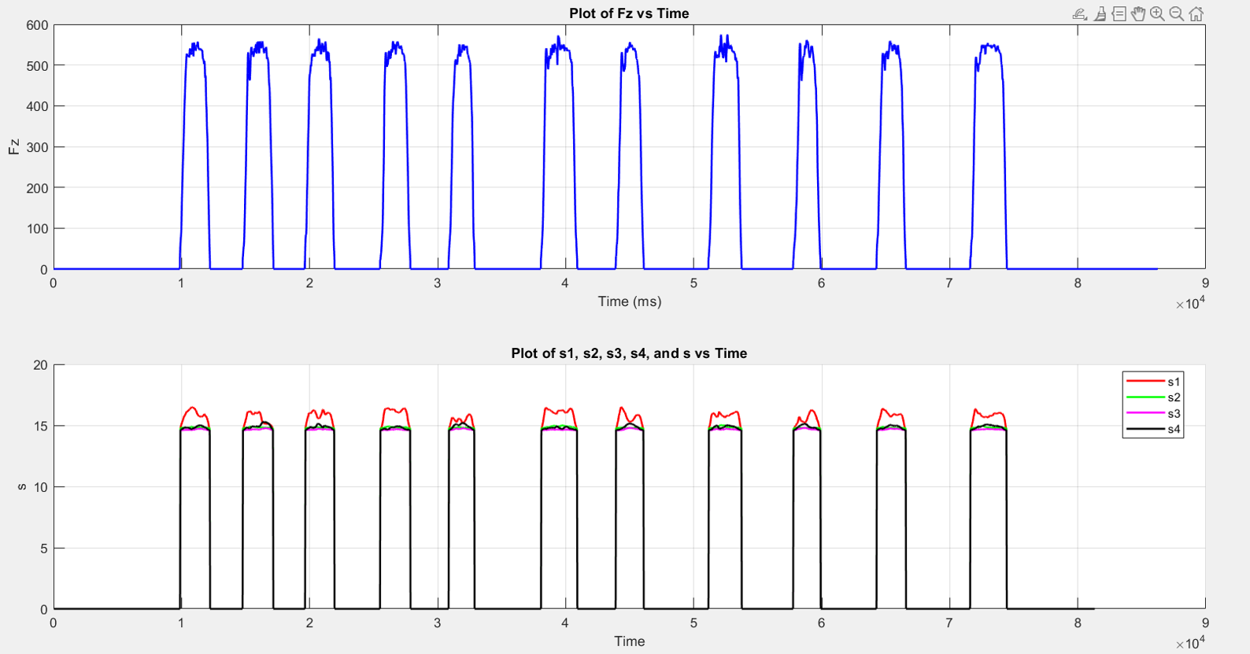
Temporary data collections
Data after removing extra data from shoe data

Slide 8
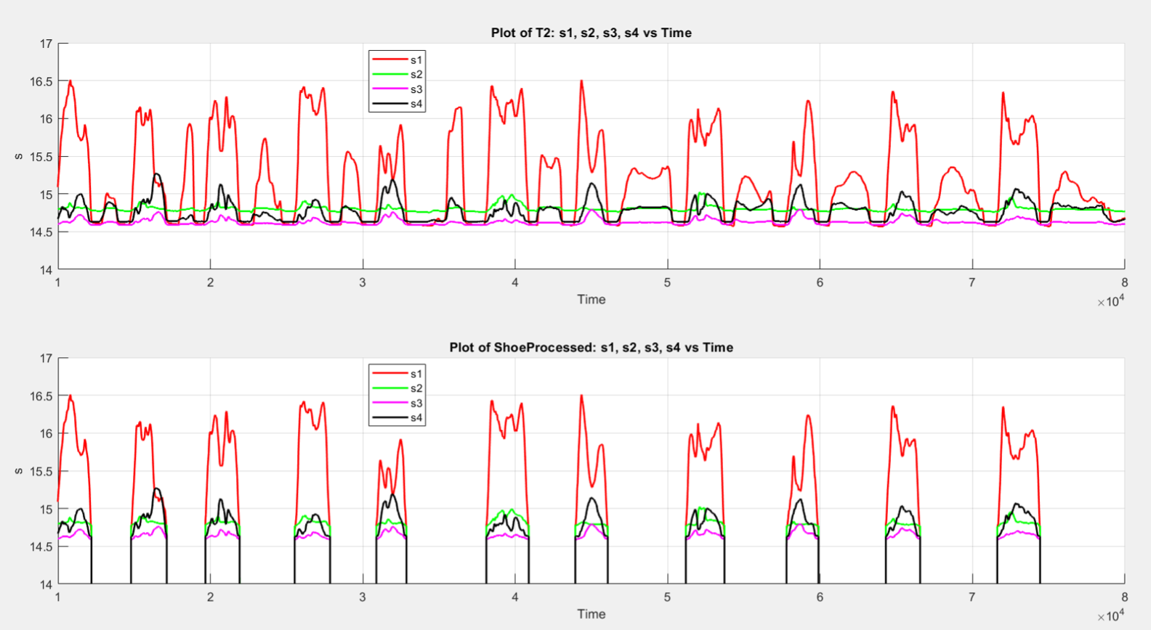
Temporary data collections
Comparison with original data

Slide 9
What next ?
Down Sampling of data using time stamp as reference.
Starting Subject experiments for data collection. (Squats)
Processing of data and combining both datasets for training of deep learning model for GRF estimation.
Switching between various machine learning techniques for better estimation and higher accuracy.

